Slide 1
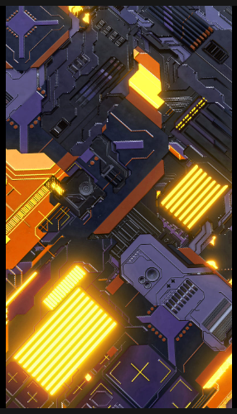
Code Comment Classification Prepared By : 1705087 1705089
01

Slide 2
Problem definition
The Code Comment Classification is a competition to build and evaluate binary classifiers to classify class comment sentences into categories representing the type of information conveyed.
A dataset of 6738 sentences and 19 baseline classifiers will be provided. We must train, tune and evaluate their classifiers using provided sets.
Evaluation will be based on a formula that accounts for overall F1 score and proportion of classifiers outperforming baselines, with the goal of improving as many baselines as possible.

Slide 3
Data Set Links
. These comments were extracted from 20 open-source projects
Java (2417): https://github.com/nlbse2023/code-comment-classification/tree/main/java/input
Pharo (1765): https://github.com/nlbse2023/code-comment-classification/tree/main/pharo/input
Python (2555): https://github.com/nlbse2023/code-comment-classification/tree/main/python/input

Slide 4
CSV Data Structure
The dataset is a collection of 6738 class comment sentences in CSV format, with one file per programming language in the input folder. Each row represents an instance and contains 6 columns:
Comment sentence id: a unique identifier for the sentence
Class : the class name of the sentence's source code file
Comment sentence: the sentence string from a multi-line class comment
Partition : dataset split into training and testing, 0 for training and 1 for testing.
Instance type : instance type: 0 for negative, 1 for positive instances..
Category : the ground-truth or oracle category.

Slide 5
Dataset Preparation
Converting sentences to lowercase, reducing multiple line endings, removing special characters except for a-z0-9,.@#&^%!? \n, replacing periods in numbers, removing extra spaces, and splitting comments into sentences preprocesses the dataset.
Dataset is split into 80/20 training-testing split
Using NEON extracts NLP features and creates term-by-document matrices.
Using Weka to classify the comment sentences using Random Forest model
Evaluation is done using standard evaluation metrics: precision, recall, and F1-score.

Slide 6

Proposed solution
Baseline models using Weka tools: Use Weka to train and test classifiers using algorithms such as Random Forest and SMR. Prepare NLP and TEXT features using NEON and TF-IDF
Additional classifiers: Use pre-trained models such as RoBERTa, FastText, and Word2Vec to extract features and train classifiers. Compare with baseline models.
As an last additional step to the proposed architecture, we may add a neural network component such as LSTM, GRU, and CNN and fine-tune them for better performance. We may be benefit from its ability to learn complex non-linear relationships and feature representations from raw data.

Slide 7
Main possible Challenges
The dataset provided for the competition may have an imbalance in the number of instances for each category, which can affect the performance of classifiers.
Understanding the domain and context of the class comments may be necessary to build accurate classifiers, but this knowledge may not be readily available
The dataset may contain a large number of features which can lead to difficulties like overfitting and poor performance of classifiers.
The class comments may contain noise such as irrelevant or redundant information, which can make it difficult for classifiers
The dataset provided for the competition is limited in size, which can make it difficult to train and evaluate
The evaluation metric may not well designed for the task

Slide 8
Performance metrics
1
2
The overall F1 Score F1 score is a measure that balances precision and recall. Here we have to take into account the performance of each classifier across all categories. The higher the average F1 score, the better the performance of the classifiers.
Portion of classsifiers that improved We have to improve as many baseline classifiers as possible with formula calculates the proportion of classifiers .The higher the proportion of classifiers that improve the baseline classifiers, the better the performance of the classifiers.

Slide 9
Thank you!
I’m so grateful for your patience

